Slide 1
Chapter 6
Data Types

Slide 2
Chapter 6 Topics
Primitive Data Types
Character String Types
Enumeration Types
Structured data types (data structure)
Array Types
Associative Arrays
Record Types
Tuple Types
List Types
Union Types
Pointer and Reference Types

Slide 3
Introduction
A data type defines a collection of data values and a set of predefined operations on those values
It is crucial; a language supports an appropriate collection of data types and structures for the real-world problems
The concepts of data typing have evolved from a few basic types to structured data types

Slide 4
Introduction
A descriptor is the collection of the attributes of a variable
An object represents an instance of a user-defined (abstract data) type
One design issue for all data types: What operations are defined and how are they specified?

Slide 5
Primitive Data Types
Data types that are not defined in terms of other types are called primitive data types
Almost all programming languages provide a set of primitive data types
To provide the structured types, the primitive data types of a language are used, along with one or more type constructors.

Slide 6
Primitive Data Types
Numeric types
Integer
Floating-point
Complex
Decimal
Boolean types
Character types

Slide 7
Primitive Data Types: Integer
The most common primitive numeric data type is integer
If precision is important, use integer
There may be different integer types
Java’s integer definitions: byte, short, int, long
C++ integer definition: short, int, long
Example 10, 100, -786, 080, 1000000

Slide 8
Primitive Data Types: Integer
Data types in C++ | Bit Width | Range
int | 4bytes | -2,147,483,648 to 2,147,483,647
unsigned int | 4bytes | 0 to 4,294,967,295
short int | 2bytes | -32,768 to 32,767
unsigned short int | 2bytes | 0 to 65,535
How can we calculate the max limit?

Slide 9
Primitive Data Types: Integer
int i=4294967295;
unsigned int ui=4294967295;
short int si=32768;
int ii= 2147483649; // shifts
cout << " int i=4294967295 ==> " << i ;
cout << "\n unsigned int ui=4294967295; ==> "<< ui ;
cout << "\n int ii= 2147483649; ==> "<< ii ;
cout << "\n short int
int i=4294967295 ==> -1
unsigned int ui=4294967295; ==> 4294967295
int ii= 2147483649; ==> -2147483647
short int si=32768; ==> -32768si=32768; ==> "<< si ;

Slide 10
Primitive Data Types: Floating Point
a number that can contain a fractional part
Model real numbers, but only as approximations for many real values
Example
0.0, 15.2, -21.9, 32.3+e18, 70.2-e12

Slide 11
What is the output of the code?
float f=1234567890, h;
cout << "\n " << f ;
h = f + 1;
cout << "\n " << h ;
1.234567e+09
1.234567e+09

Slide 12
Primitive Data Types: Floating Point
Data Type | Bit Width | Range
float | 4bytes | +/- 3.4e +/- 38 (~7 digits)
double | 8bytes | +/- 1.7e +/- 308 (~15 digits)
Double, and Floating point types are different in the way that they store the values.
Double type saves greater numbers but losses the accuracy

Slide 13
Floating Point and double
#include <stdio.h>
int main()
{ double db = 0, da = 1.0 / 81;
float fb = 0, fa = 1.0 / 81;
int i;
for ( i= 0; i < 729; i++ )
{ db += da;
fb += fa; }
printf("%.15g\n", db);
printf("%.7g\n", fb);
}
8.99999999999996
9.000023

Slide 14
Primitive Data Types: Floating Point
Example, numbers π and e (the base for the natural logarithms) can be correctly represented in floating-point notation, in any finite space.
Another problem with floating-point types is the loss of accuracy through arithmetic operations

Slide 15
Primitive Data Types: Floating Point
Languages for scientific use support at least two floating-point types (e.g., float and double; sometimes more
IEEE Floating-Point
Standard 754

Slide 16
float f=1234.7;
printf("\n%f\n", f); 1234.699951
f=f+1;
printf("\n%f\n", f); 1235.699951
f=123456789; float h;
printf("\n%.15g\n", f); 123456792
h = f + 1;
printf("\n%.15g\n", h); 123456792

Slide 17
What is the output of the code?
public class HelloWorld{
public static void main(String []args){ System.out.println(100/2); System.out.println((1/2)*100); System.out.println(1/2*100); System.out.println(100*1/2);
}}
50
0
0
50

Slide 18
What is the output of the code?
public class HelloWorld{
public static void main(String []args){ System.out.println(100/2); System.out.println((1./2)*100); System.out.println(1./2*100); System.out.println(100*1/2); }}
50
50.0
50.0
50

Slide 19
What is the output of the code?
public class HelloWorld{
public static void main(String []args){ System.out.println(99/2); System.out.println((1./2)*99); System.out.println(1./2*99); System.out.println(99*1/2); }}
49
49.5
49.5
49

Slide 20
Primitive Data Types: Complex
Some languages support a complex type, e.g., C99, Fortran, and Python
Each value consists of two floats, the real part and the imaginary part
Literal form (in Python):
(7 + 3j), where 7 is the real part and 3 is the imaginary part
Fourier analysis, mechanical and aerospace engineering

Slide 21
Primitive Data Types: Decimal
Decimal data types store a fixed number of decimal digits, with the decimal point at a fixed position in the value.
These are the primary data types for business data processing
The operations on decimal values are done in hardware on machines that have such capabilities;
otherwise, they are simulated in software.

Slide 22
Primitive Data Types: Decimal
Advantage: accuracy, precisely store decimal values, at least those within a restricted range, which cannot be done with floating-point.
Example, the number 0.1 (in decimal) can be exactly represented in a decimal type, but not in a floating-point type (0.0001100110011 . . . in binary.)
Disadvantages: limited range because no exponents are allowed, wastes memory

Slide 23
Primitive Data Types: Decimal
Decimal types are stored very much like character strings, using binary codes for the decimal digits.
These representations are called binary coded decimal (BCD).
In some cases, they are stored one digit per byte, but in others, they are packed two digits per byte.
Either way, they take more storage than binary representations. It takes at least four bits to code a decimal digit

Slide 24
Primitive Data Types: Decimal
COBOL, C# and F# also have decimal data types.

Slide 25
Primitive Data Types: Boolean
Simplest of all types
Range of values: two elements, one for “true” and one for “false”
In most general-purpose languages
It could be represented by a single bit, but because a single bit of memory cannot be accessed efficiently on many machines, they are often stored in the smallest efficiently addressable cell of memory, typically a byte.

Slide 26
Primitive Data Types: Boolean
They are often used to represent switches or flags in programs.
Other types, such as integers, can be used for these purposes, but Boolean types is more readable.
C++ have a Boolean type, they also allow numeric expressions to be used as if they were Boolean.
Java and C# support

Slide 27
Primitive Data Types: Character
Stored as numeric codings
16-bit coding: Unicode (UCS-2)
Includes characters from most natural languages
Java, C#, Python, Perl, F# and JavaScript support Unicode
32-bit, 4-byte character code, Unicode (UCS-4)

Slide 28
Character String Types
Values are sequences of characters
Typical operations:
Assignment and copying
Comparison (=, >, etc.)
Catenation
Substring reference
Pattern matching

Slide 29
Character String Type in Certain Languages - C and C++
Use char arrays to store character strings and a collection of string operations through standard libraries
character strings are terminated with a special character, null, which is represented with zero.
The library operations carry out their operations until the null character appears in the string being operated on. Library functions that produce strings often supply the null character.

Slide 30
Character String Type in Certain Languages - C and C++
Use char arrays to store character strings and a collection of string operations through standard libraries
char str[] = "apples";
str is an array of char elements, specifically apples0, where 0 is the null character.

Slide 31
Character String Type in Certain Languages - C and C++
Some of the most commonly used library functions for character strings
strcpy, moves strings;
strcat, concatenates one given string onto another;
strcmp, lexicographically compares
strlen, returns the number of characters, not counting the null

Slide 32
Character String Type in Certain Languages - Java,
Strings are supported by the String class, whose values are constant strings,
the StringBuffer class, whose values are changeable and are more like arrays of single characters.
These values are specified with methods
of the StringBuffer class.
C# and Ruby include string classes that are similar to those of Java.

Slide 33
Character String Type in Certain Languages - Python
includes strings as a primitive type
and has operations for substring, reference, catenation, indexing to access individual characters, as well as methods for searching and replacement.
they act very much like arrays of characters.
Python strings are similar to the String class objects of Java.

Slide 34
Character String Length Options
The length can be static and set when the string is created.
called a static length string.
Python, the immutable objects of Java’s String class, similar classes in the C++
Ruby’s built-in String class, and
The .NET class library available to C# and F#.

Slide 35
Character String Length Options
The strings can have varying length up to a
declared and fixed maximum set by the variable’s definition,
called limited dynamic length strings
by the strings in C and the C-style strings of C++.
Such string variables can store any number of characters between zero and the maximum.

Slide 36
Character String Length Options
The strings may have varying length with no maximum,
Called dynamic length strings
JavaScript, Perl, and the standard C++ library.
This option requires the overhead of dynamic storage allocation and deallocation but provides maximum flexibility.

Slide 37
Character sorting
How to sort these words?
Apple, Train, Cool, Moon
Şeker, Bal, Öykü, Nar, Elma
Sort command sorts by using English alphabet
Sorting algorithms are required for different letters

Slide 38
Enumeration Types
All possible values, which are named constants, are provided in the definition
C# example
enum days {mon, tue, wed, thu, fri, sat, sun};
Enumeration types provide a way of defining and grouping collections of named constants, which are called enumeration constants.

Slide 39
Enumeration Types
In languages that do not have enumeration types, programmers usually simulate them with integer values.
Example, to represent colors in a program which doesnt have an enumeration type;
0 to represent blue, 1 to represent red, defined as follows:
int red = 0, blue = 1;

Slide 40
Enumeration Types
Enumeration types can provide advantages in both readability and reliability.
Readability is enhanced very directly: Named values are easily recognized,
C++, C#, Java 5.0, Pascal and Ada support for enumeration

Slide 41
Array Types
An array is a homogeneous aggregate of data elements in which an individual element is identified by its position in the aggregate, relative to the first element.
References to array elements are using subscript
The individual data elements are same type

Slide 42
Heterogeneous Arrays
A heterogeneous array is one in which the elements need not be of the same type
Supported by Perl, Python, JavaScript, and Ruby
Python ; List=[‘abcd’,34,’sd’,63]

Slide 43
Array Types
In many languages, such as C, C++, Java, Ada, and C#, all elements of an array are required to be of the same type
In some other languages, such as JavaScript, Python, and Ruby, arrays still consist of elements of a single type, but the elements can reference objects or data values of different types.
C# and Java 5.0 provide generic arrays, the elements are references to objects, through their class libraries

Slide 44
Array Indexing
Indexing (or subscripting) is a mapping from indices to elements
array_name (index_value_list) → an element
Index Syntax
Fortran and Ada use parentheses
Ada explicitly uses parentheses to show uniformity between array references and function calls because both are mappings
Most other languages use brackets

Slide 45
Array Initialization
Some language allow initialization at the time of storage allocation
C, C++, Java, C# example
int list [] = {4, 5, 7, 83}
Character strings in C and C++
char name [] = ″freddie″;
Arrays of strings in C and C++
char *names [] = {″Bob″, ″Jake″, ″Joe″};
Java initialization of String objects
String[] names = {″Bob″, ″Jake″, ″Joe″};

Slide 46
Array Initialization
C-based languages
int list [] = {1, 3, 5, 7}
char *names [] = {″Mike″, ″Fred″, ″Mary Lou″};
Ada
List : array (1..5) of Integer :=
(1 => 17, 3 => 34, others => 0);
Python
myList=[1,2,3,4,5,6]

Slide 47
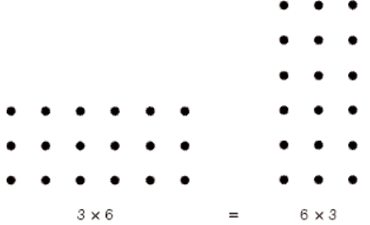
Rectangular and Jagged Arrays
A rectangular array is a multi-dimensioned array in which all of the rows have the same number of elements and all columns have the same number of elements
Rectangular arrays model rectangular tables exactly.

Slide 48
Rectangular and Jagged Arrays
J# 2-D rectangular array; explicit creation.
int[,] arr = new int[2, 2];
arr[0, 0] = 1;
arr[0, 1] = 2;
arr[1, 0] = 3;
arr[1, 1] = 4;

Slide 49
Rectangular and Jagged Arrays
A jagged matrix has rows with varying number of elements
Example, it may consist of 3 rows, one with 5 elements, one with 7 elements, and one with 12 elements. This also applies to the columns and higher dimensions.
If there is a third dimension (layers), each layer can have a different number of elements.
A multidimensioned array may consists arrays of arrays.

Slide 50
Rectangular and Jagged Arrays
A multidimensioned array may consists arrays of arrays.
Video data and CT scans are processed by using 3-D arrays

Slide 51
Rectangular and Jagged Arrays
C, C++, and Java support jagged arrays
a reference to an element of a multi-dimensioned array uses a separate
pair of brackets for each dimension.
myArray[3][7]
int jagged_row0[] = {0,1};
int jagged_row1[] = {1,2,3};
int *jagged[] = { jagged_row0, jagged_row1 };

Slide 52
Rectangular and Jagged Arrays
Fortran, Ada supports rectangular arrays
all subscript expressions in references to elements are placed in a single pair of brackets
myArray[3, 7]
C# supports rectangular and jagged arrays

Slide 53
Slices
A slice of an array is some substructure of that array.
A is a matrix, the first row or the last row or the first column of A is one possible slice
A slice is not a new data type. it is a mechanism for referencing part of an array as a unit.
If arrays cannot be manipulated as units in a language, that language has no use for slices.

Slide 54
Slices
A matrix declarations in Python:
mat = [[1, 2, 3],[4, 5, 6],[7, 8, 9]]
The syntax of a Python slice reference is a pair of numeric expressions separated by a colon
mat[1] refers to the second row of mat; mat[0][0:2] refers to the first and second element of the first row of mat, which is
[1, 2].

Slide 55
Associative Arrays
An associative array is an unordered collection of data elements that are indexed by an equal number of values called keys
In the non-associative arrays, the indices never need to be stored but in an associative array, the user-defined keys must be stored in the structure.
So each element of an associative array is in fact a pair of entities, a key and a value.

Slide 56
Associative Arrays
Associative arrays are supported directly by Perl, Python, Ruby, and Lua and
by the standard class libraries of Java, C++, C#, and F#.

Slide 57
Associative Arrays in Perl
In Perl, associative arrays are called hashes,
their elements are stored and retrieved with hash functions.
Every hash variable name must begin with %
Each hash element consists of two parts: a key, which is a string, a value, which is a scalar (number, string, or reference)

Slide 58
Associative Arrays in Perl
In Perl, an example
%salaries = ("Gary" => 75000, "Perry" => 57000,
"Mary" => 55750, "Cedric" => 47850);
Assignment
$salaries ("Perry“) = 57777;
Delete
Delete $salaries ("Perry“) ;

Slide 59
Record Types
A record is an aggregate of data elements in which the individual elements are identified by names and accessed through offsets from the beginning of the structure.
There is frequently a need in programs to model a collection of data in which the individual elements are not of the same type or size.

Slide 60
Record Types
Records have been part of all of the most popular programming languages, when they were introduced by COBOL.
In some languages that support object-oriented programming, data classes serve as records.
In C, C++, and C#, records are supported with the struct data type.
In Python and Ruby, records can be implemented as hashes, can be elements of arrays.

Slide 61
Record Types
The fundamental difference between a record and an array is that record elements,
or fields, are not referenced by indices. Instead, the fields are named with identifiers, and references to the fields are made using these identifiers.
Another difference is that records in some languages are allowed to include unions

Slide 62
Record Types
In C++, structures are a minor variation on classes.
In C#, structs are also related to classes, but are also quite different. C# structs are stack-allocated value types, as opposed to class objects, which are heap-allocated reference types. Structs
in C++ and C# are normally used as encapsulation structures, rather than data
structures.

Slide 63
Record Types, For example,
Information about a college student might include name, student number, grade point average, and so forth.
A data type for
a character string for the name,
an integer for the student number,
a floating point for the grade point average,

Slide 64
Records with struct C, C++, C#
struct student {
char name [20];
int number;
float grade_average;
};
struct student class1;
class1.name = “John”;

Slide 65
Definition of Records in COBOL
COBOL uses level numbers to show nested records; others use recursive definition
01 EMP-REC.
02 EMP-NAME.
05 FIRST PIC X(20).
05 MID PIC X(10).
05 LAST PIC X(20).
02 HOURLY-RATE PIC 99V99.

Slide 66
Definition of Records in Ada
Record structures are indicated in an orthogonal way
type Emp_Rec_Type is record
First: String (1..20);
Mid: String (1..10);
Last: String (1..20);
Hourly_Rate: Float;
end record;
Emp_Rec: Emp_Rec_Type;

Slide 67
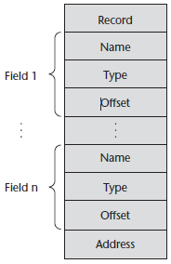
Record Types
A compile-time
descriptor for a record

Slide 68
References to Records
Record field references
1. COBOL
field_name OF record_name_1 OF ... OF record_name_n
2. Others (dot notation)
record_name_1.record_name_2. ... record_name_n.field_name
Fully qualified references must include all record names
Elliptical references allow leaving out record names as long as the reference is unambiguous, for example in COBOL
FIRST, FIRST OF EMP-NAME, and FIRST of EMP-REC are elliptical references to the employee’s first name

Slide 69
Operations on Records
Assignment is very common if the types are identical
Ada allows record comparison
Ada records can be initialized with aggregate literals
COBOL provides MOVE CORRESPONDING
Copies a field of the source record to the corresponding field in the target record

Slide 70
Evaluation and Comparison to Arrays
Records are used when collection of data values is heterogeneous
Access to array elements is much slower than access to record fields, because subscripts are dynamic (field names are static)
Dynamic subscripts could be used with record field access, but it would disallow type checking and it would be much slower

Slide 71
Evaluation and Comparison to Arrays
Records are frequently valuable data types in programming languages.
The design of record types is straightforward, and their use is safe.
Arrays are used when all the data values have the same type and/or are processed in the same way by using dynamic subscripting as the addressing method.

Slide 72
Evaluation and Comparison to Arrays
Records are used when the collection of data values is heterogeneous and the different fields are not processed in the same way.
When the fields of a record need not be processed in a particular order.
Field names provide very efficient access to the fields.

Slide 73
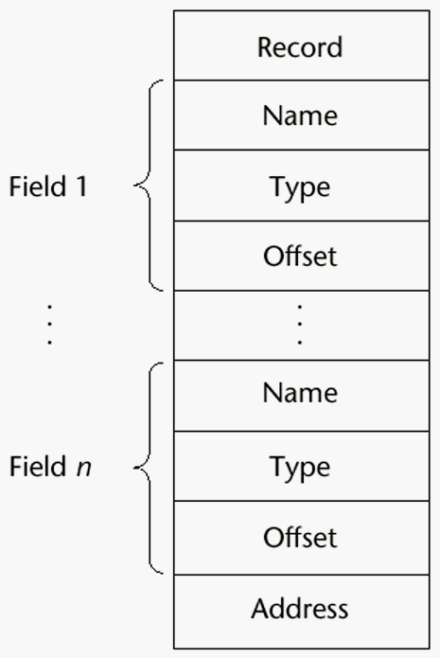
Implementation of Record Type
Offset address relative to the beginning of the records is associated with each field

Slide 74
Tuple Types
A tuple is a data type that is similar to a record, except that the elements are not named
Used in Python, ML, and F# to allow functions to return multiple values

Slide 75
Tuple Types in Python
It has an immutable tuple type.
One use of tuples is when an array must be write protected, such as when it is sent as a parameter to an external function and the user does not want the function to be able to modify the parameter.

Slide 76
Tuple Types in Python
If a tuple needs to be changed, it can be converted to an array with the list function.
After the change, it can be converted back to a tuple with the tuple function.
The elements of a tuple need not be of the same type.

Slide 77
Tuple Types in Python
It is created by assigning a tuple literal, myTuple = (3, 5.8, 'apple')
The elements of a tuple can be referenced with indexing in brackets,
myTuple[1]
Tuples can be deleted with the del statement.
There are also other operators and functions that operate on tuples.

Slide 78
List Types
Lists were first supported in the first functional programming language, LISP.
They have always been part of the functional languages, but in recent years they have found their way into some imperative languages.
C# and Java support List and ArrayList classes. These structures are actually lists.

Slide 79
List Types
Lists in Common LISP and Scheme are delimited by parentheses and the elements are not separated by any punctuation
(A B C D)
Nested lists have the same form
(A (B C) D)
In this list, (B C) is a list nested inside the outer list.

Slide 80
List Types
Data and code have the same form
As data, (A B C) is literally what it is
As code, (A B C) is the function A applied to the
parameters B and C
The interpreter needs to know which a list is, so if it is data, we quote it with an apostrophe
′(A B C) is data

Slide 81
List Types (continued)
List Operations in Scheme
CAR returns the first element of its list parameter
(CAR ′(A B C)) returns A
CDR returns the remainder of its list parameter after the first element has been removed
(CDR ′(A B C)) returns (B C)
- CONS puts its first parameter into its second parameter, a list, to make a new list
(CONS ′A (B C)) returns (A B C)
LIST returns a new list of its parameters
(LIST ′A ′B ′(C D)) returns (A B (C D))

Slide 82
List Types (continued)
Python Lists
The list data type also serves as Python’s arrays
Unlike Scheme, Common LISP, ML, and F#, Python’s lists are mutable
Elements can be of any type
Create a list with an assignment
myList = [3, 5.8, "grape"]

Slide 83
List Types (continued)
Python Lists (continued)
List elements are referenced with subscripting, with indices beginning at zero
x = myList[1] Sets x to 5.8
List elements can be deleted with del
del myList[1]
List Comprehensions – derived from set notation
[x * x for x in range(6) if x % 3 == 0]
range(12) creates [0, 1, 2, 3, 4, 5, 6]
Constructed list: [0, 9, 36]

Slide 84
Unions Types
A union is a type whose variables are allowed to store different type values at different times during execution
The values are stored in the same location
Unions are potentially unsafe constructs in some languages.
That’s why C and C++ are not strongly typed, they do not allow type checking of references to their unions.

Slide 85
Unions Types, C++ example
union flexType
{ int intEl;
int intEl2;
float floatEl;
};
union flexType el1;
int x;
float y;
el1.intEl = 27;
x = el1.intEl2;
y = el1.floatEl;

Slide 86
Discriminated vs. Free Unions
Fortran, C, and C++ provide union constructs in which there is no language support for type checking; the union in these languages is called free union
Type checking of unions require that each union include a type indicator called a discriminant
Supported by Ada

Slide 87
Evaluation of Unions
Free unions are unsafe
Do not allow type checking
Java and C# do not support unions
Reflective of growing concerns for safety in programming language
Ada’s descriminated unions are safe

Slide 88
Pointer and Reference Types
A pointer type variable has a range of values that consists of memory addresses and a special value, nil
nil is not a valid address, indicates a pointer cannot currently be used to reference a memory cell
They are used to reference some other variable, rather than being used to store data.

Slide 89
Pointer and Reference Types
Provide the power of indirect addressing
Provide a way to manage dynamic memory for the structures like linked list

Slide 90
Pointer Operations
int j=4;
int *ptr;
ptr = &j;
cout<<“j= "<<j << " *ptr= "<<*ptr<< " ptr= " << ptr;
Result
j=4 *ptr= 4 ptr=0x28ff48

Slide 91
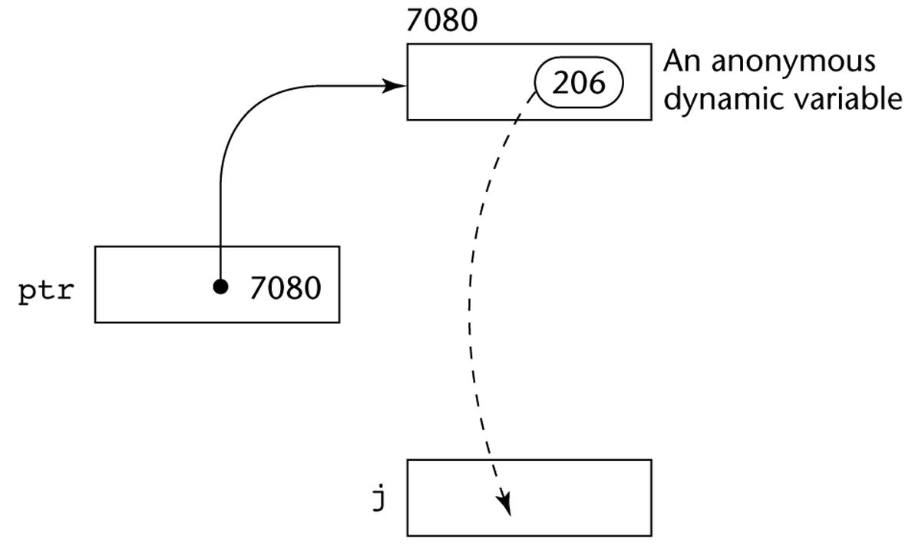
Pointer Assignment Illustrated

Slide 92
Pointers in C and C++
Extremely flexible but must be used with care
Pointers can point at any variable regardless of when or where it was allocated
Used for dynamic storage management and addressing
Pointer arithmetic is possible

Slide 93
Pointer Arithmetic in C and C++
float stuff[100];
float *p;
p = stuff;
*(p+5) is equivalent to stuff[5] and p[5]
*(p+i) is equivalent to stuff[i] and p[i]

Slide 94
Reference Types
A reference type variable is similar to a pointer, with one difference:
A pointer refers to an address in memory,
reference refers to an object or a value in memory.
it is not sensible to do arithmetic on references.

Slide 95
Reference Types
C++ includes a special kind of pointer type called a reference type that is used primarily for formal parameters
Advantages of both pass-by-reference and pass-by-value
Java extends C++’s reference variables and allows them to replace pointers entirely
References are references to objects, rather than being addresses
C# includes both the references of Java and the pointers of C++

Slide 96
Reference Types
Reference type variables are specified in definitions by preceding their names with ampersands (&). For example,
In this code segment, result and ref_result are aliases.
int result = 0;
int &ref_result = result;
cout <<result << &ref_result <<&result;
Result 0 0x22ff3c 0x22ff3c

Slide 97
Evaluation of Pointers
Pointers or references are necessary for dynamic data structures--so we can't design a language without them

Slide 98
Type Checking
The concept of operands and operators to include subprograms (subprograms are operators and operands are their parameters) and assignments
Type checking is the activity of ensuring that the operands of an operator are of compatible types

Slide 99
Type Checking
A compatible type is one that is either legal for the operator, or is allowed under language rules to be implicitly converted, by compiler- generated code, to a legal type
This automatic conversion is called a coercion.

Slide 100
Type Checking
if an int variable and a float variable are added, the value of the int variable is coerced to float and a floating-point add is done
int c=4, e; float b, d=3.5;
b = d + c;
e = d + c;
printf("\n e=%d b=%5.5f",e,b);

Slide 101
Type Checking
It is better to detect errors at compile time than at run time, because the earlier correction is usually less costly
Dynamic type binding requires type checking at run time
If all type bindings are static, nearly all type checking can be static
If type bindings are dynamic, type checking must be dynamic

Slide 102
Strong Typing
A programming language is strongly typed if type errors are always detected
Advantage of strong typing: allows the detection of the misuses of variables that result in type errors

Slide 103
Strong Typing
Language examples:
C and C++ are not: parameter type checking can be avoided; unions are not type checked
Java and C# are almost

Slide 104
Summary
The data types of a language are a large part of what determines that language’s style and usefulness
The primitive data types of most imperative languages include numeric, character, and Boolean types
The user-defined enumeration and subrange types are convenient and add to the readability and reliability of programs
Arrays and records are included in most languages
Pointers are used for addressing flexibility and to control dynamic storage management

